Slide 1
Connecting
All the units must be connected
Different type of connection for different type of unit
  Memory
  Input/Output
  CPU

Slide 2

Computer Modules

Slide 3
Memory Connection
Receives and sends data
Receives addresses (of locations)
Receives control signals
  Read
  Write
  Timing – Clock Signal

Slide 4
Input/Output Connection(1)
Similar to memory from computer’s viewpoint
Output
  Receive data from computer
  Send data to peripheral
Input
  Receive data from peripheral
  Send data to computer

Slide 5
Input/Output Connection(2)
Receive control signals from computer
Send control signals to peripherals
  e.g. spin disk
Receive addresses from computer
  e.g. port number to identify peripheral
Send interrupt signals (control)
  E.g no paper (printer)

Slide 6
CPU Connection
Reads instruction and data
Writes out data (after processing)
Sends control signals to other units
Receives (& acts on) interrupts

Slide 7
Buses
There are a number of possible interconnection systems
Single and multiple BUS structures are most common
e.g. Control/Address/Data bus (PC)
e.g. Unibus (DEC-PDP)

Slide 8
What is a Bus?
A communication pathway connecting two or more devices
Usually broadcast
Often grouped
  A number of channels in one bus
  e.g. 32 bit data bus is 32 separate single bit channels
Power lines may not be shown

Slide 9
Data Bus
Carries data
  Remember that there is no difference between “data” and “instruction” at this level
Width is a key determinant of performance
  8, 16, 32, 64 bit

Slide 10
Address bus
Identify the source or destination of data
e.g. CPU needs to read an instruction (data) from a given location in memory
Bus width determines maximum memory capacity of system
  e.g. 8080 has 16 bit address bus giving 64k address space

Slide 11
Control Bus
Control and timing information
  Memory read/write signal
  Interrupt request
  Clock signals

Slide 12

Bus Interconnection Scheme

Slide 13
Big and Yellow?
What do buses look like?
  Parallel lines on circuit boards
  Ribbon cables
  Strip connectors on mother boards
    e.g. PCI
  Sets of wires

Slide 14
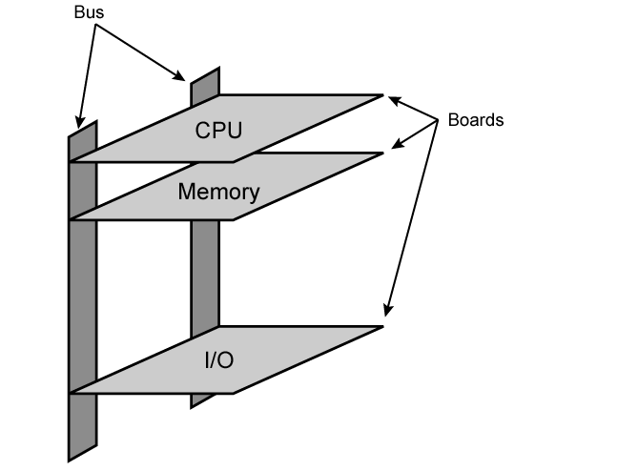
Physical Realization of Bus Architecture

Slide 15
Single Bus Problems
Lots of devices on one bus leads to:
  Propagation delays
    Long data paths mean that co-ordination of bus use can adversely affect performance
    If aggregate data transfer approaches bus capacity
Most systems use multiple buses to overcome these problems

Slide 16

Traditional (ISA)
(with cache)

Slide 17
High Performance Bus

Slide 18
Bus Types
Dedicated
  Separate data & address lines
Multiplexed
  Shared lines
  Address valid or data valid control line
  Advantage - fewer lines
  Disadvantages
    More complex control
    Ultimate performance

Slide 19
Bus Arbitration
More than one module controlling the bus
e.g. CPU and DMA controller
Only one module may control bus at one time
Arbitration may be centralised or distributed

Slide 20
Centralised or Distributed Arbitration
Centralised
  Single hardware device controlling bus access
    Bus Controller
    Arbiter
  May be part of CPU or separate
Distributed
  Each module may claim the bus
  Control logic on all modules

Slide 21
Timing
Co-ordination of events on bus
Synchronous
  Events determined by clock signals
  Control Bus includes clock line
  A single 1-0 is a bus cycle
  All devices can read clock line
  Usually sync on leading edge
  Usually a single cycle for an event

Slide 22
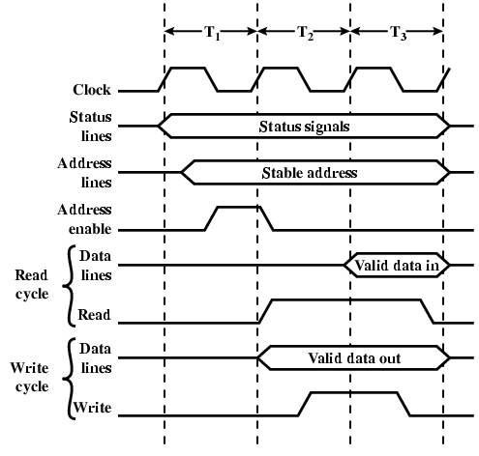
Synchronous Timing Diagram

Slide 23
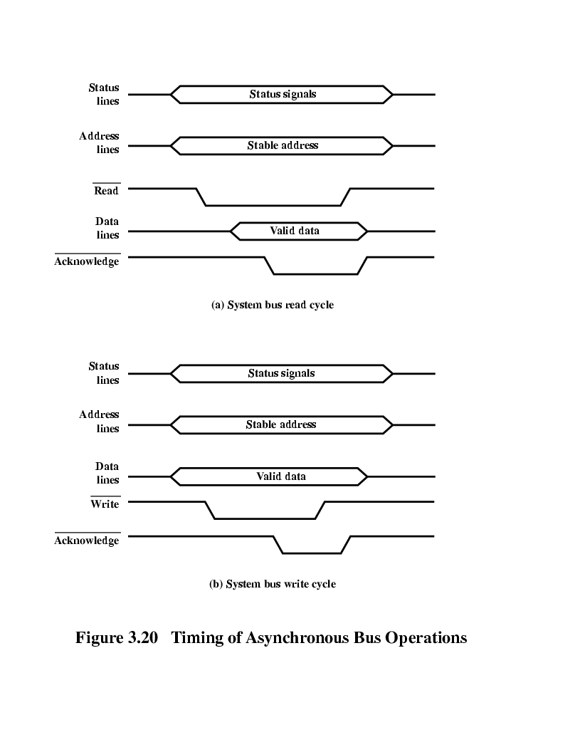
Asynchronous Timing – Read Diagram

Slide 24
Asynchronous Timing – Write Diagram

Slide 25
PCI Bus
Peripheral Component Interconnection
Intel released to public domain
32 or 64 bit
50 lines

Slide 26
PCI Bus Lines (required)
Systems lines
  Including clock and reset
Address & Data
  32 time mux lines for address/data
  Interrupt & validate lines
Interface Control
Arbitration
  Not shared
  Direct connection to PCI bus arbiter
Error lines

Slide 27
PCI Bus Lines (Optional)
Interrupt lines
  Not shared
Cache support
64-bit Bus Extension
  Additional 32 lines
  Time multiplexed
  2 lines to enable devices to agree to use 64-bit transfer
JTAG/Boundary Scan
  For testing procedures

Slide 28
PCI Commands
Transaction between initiator (master) and target
Master claims bus
Determine type of transaction
  e.g. I/O read/write
Address phase
One or more data phases

Slide 29
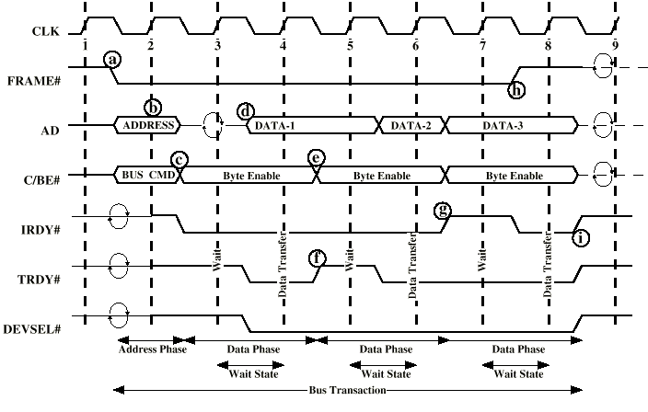
PCI Read Timing Diagram

Slide 30
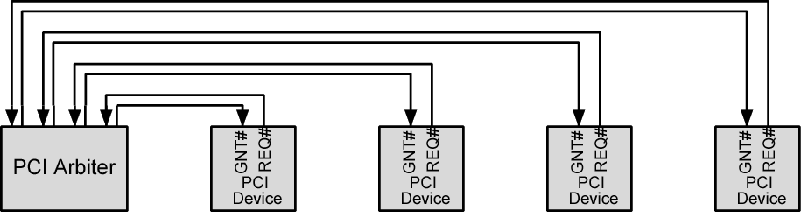
PCI Bus Arbiter

Slide 31
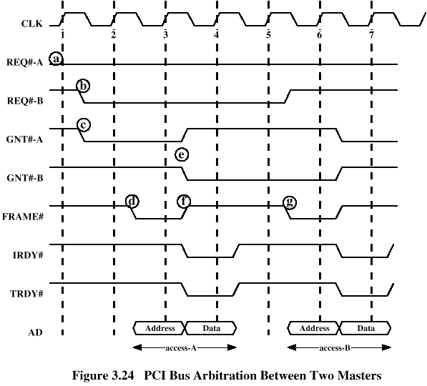
PCI Bus Arbitration

Slide 32
Foreground Reading
Stallings, chapter 3 (all of it)
www.pcguide.com/ref/mbsys/buses/
In fact, read the whole site!
www.pcguide.com/

